Slide 1
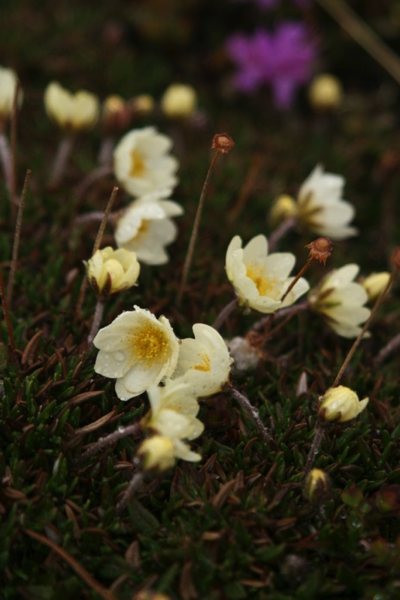
APPLES background:
Arctic plant phenology and climate change
Eric Post
The Polar Center and Department of Biology, Penn State University
Dept. of Wildlife, Fish, & Conservation Biology, UC Davis

Slide 2
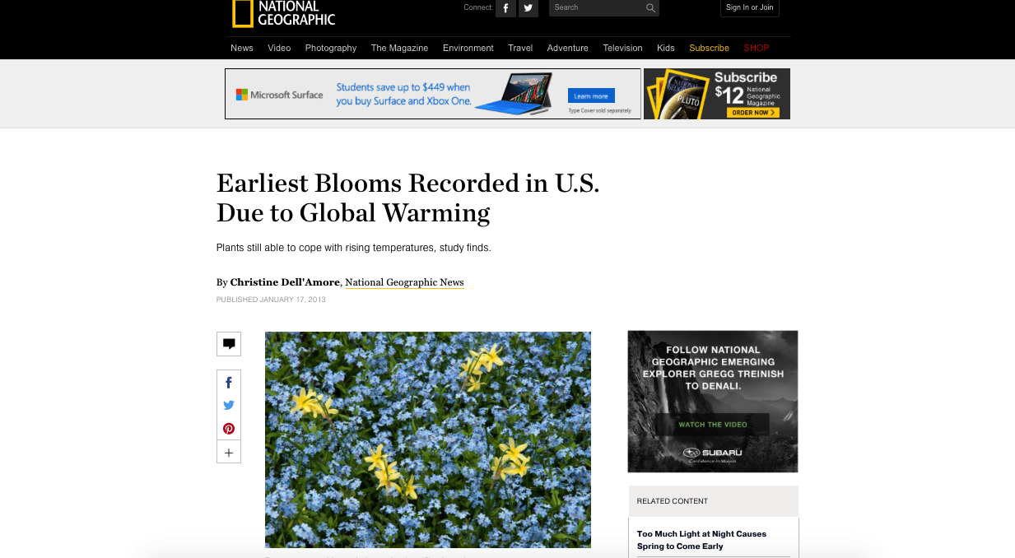
Phenology – the study of the timing of events

Slide 3
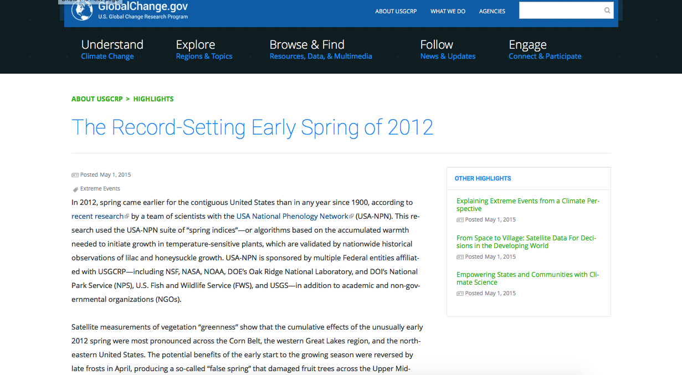
Phenology – the study of the timing of events

Slide 4
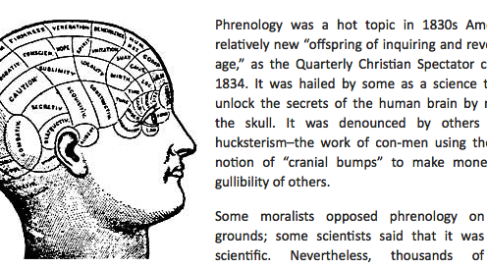
Phenology – not to be confused with phrenology

Slide 5
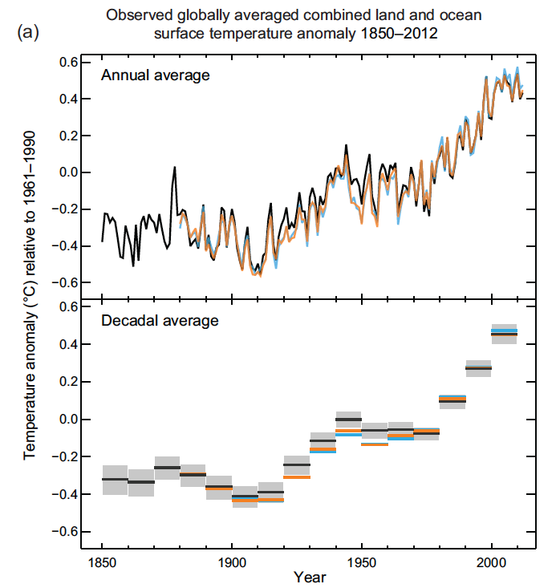
Recent warming
(IPCC AR5)

Slide 6
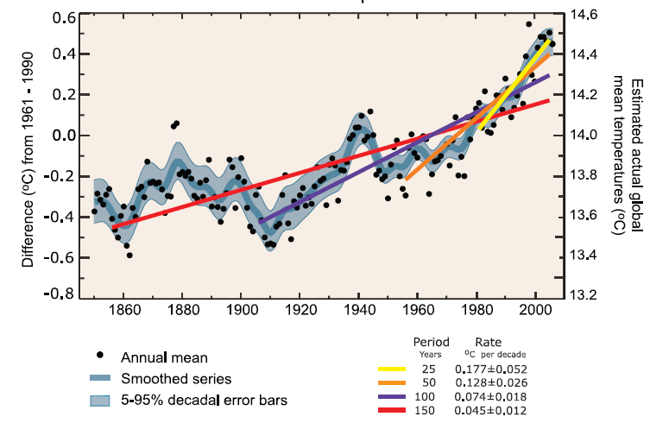
The rate of warming is increasing
(IPCC AR4)

Slide 7
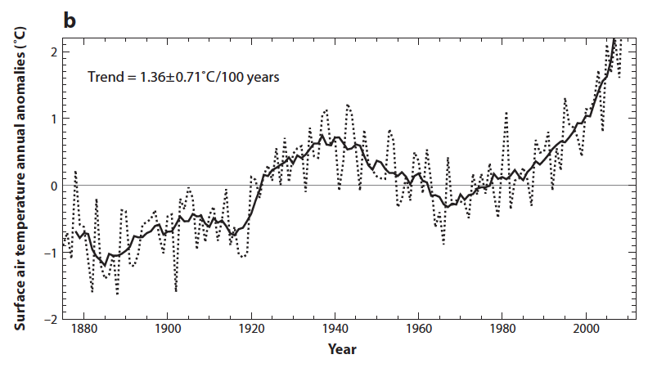
Arctic warming: twice the global average

Slide 8
Warming increases with latitude, and this relationship has intensified recently
Post, in review. Phenology, Princeton U Press.

Slide 9
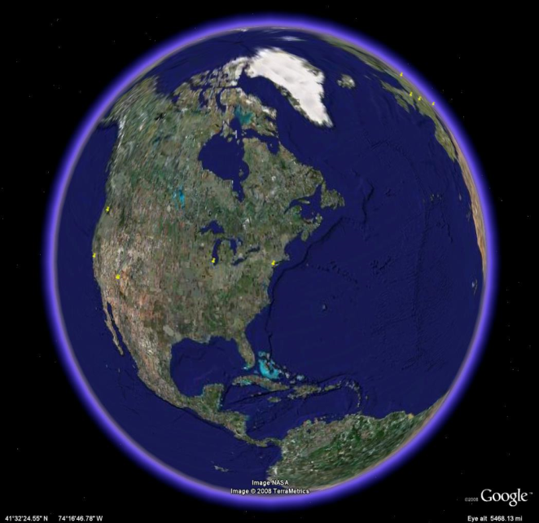
The Arctic as a study system for climate change
Changing rapidly
Very few species
  It’s a simple system
Clear species interactions
Clear climatic signals
“Canary in the coal mine.”
Kangerlussuaq, Greenland

Slide 10
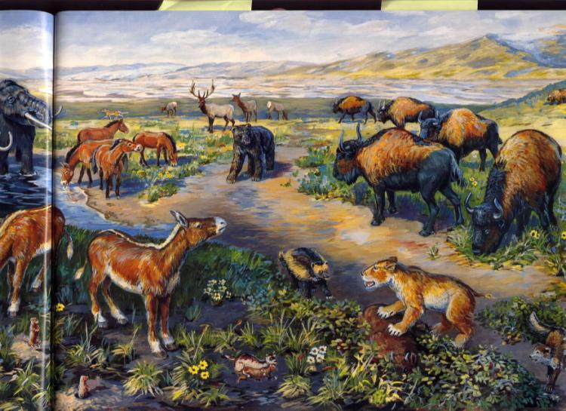
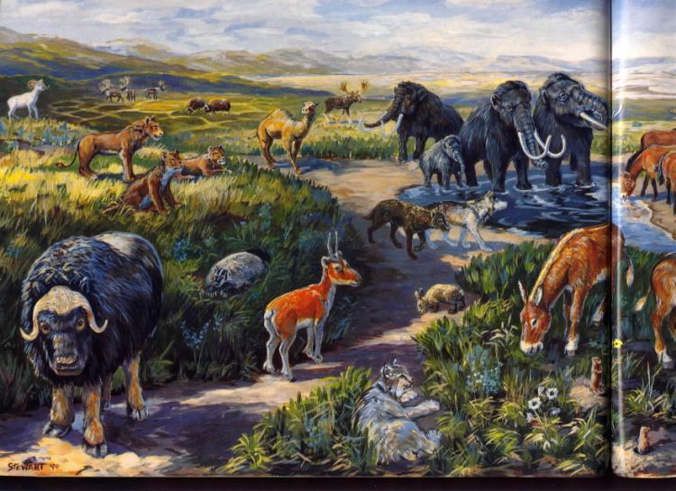
Many arctic mammals are Pleistocene relics
Advance to “GO”, collect $200
R.I.P.

Slide 11
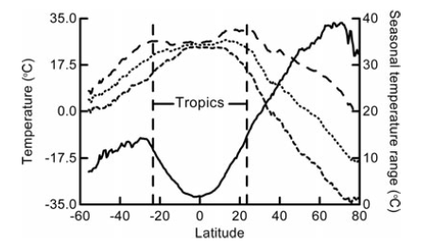
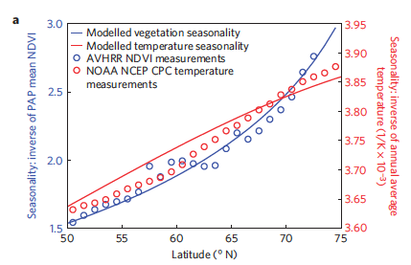
Defining feature of the Arctic: extreme seasonality
(Xu et al. 2013 Nat. Clim. Change)

Slide 12
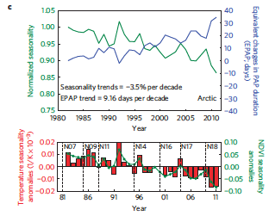
This defining feature of the Arctic is changing
Temperature- and vegetation seasonality are diminishing.
How will this affect species adapted to seasonality, and interactions among those species?
(Xu et al. 2013 Nat. Clim. Change)

Slide 13
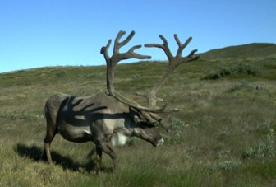
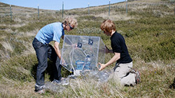
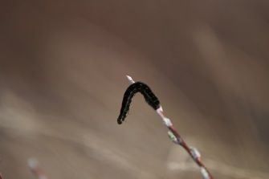
What do we do and how do we do it?
A many-branched road of scientific inquiry
25 years ago…
Hypothesis:
caribou are limited
by food availability
Collect field data
on caribou and
vegetation abundance
Conclusions
Interest in effects of
climate change on
timing of plant growth
Collect field data
on timing of plant growth
(phenology)
How does earlier plant growth
affect caribou?
Discover
“trophic mismatch”
Start warming experiment
to test effects on timing
How do experimental warming and
earlier growth affect plant abundance?
Start herbivore
exclosure experiment
Expand to include roots
How does this then affect
CO₂ exchange?
How does herbivory
Interact with warming?
Accidentally observe
caterpillar outbreak
Start gas flux
measurements
Discover new species
of fungal pathogen

Slide 14
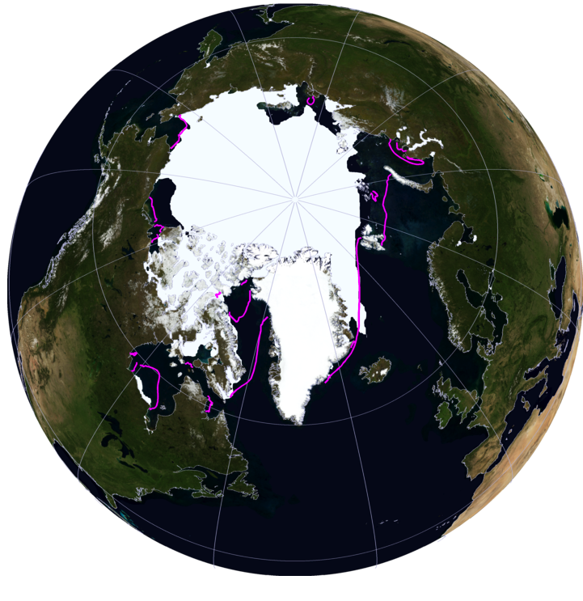
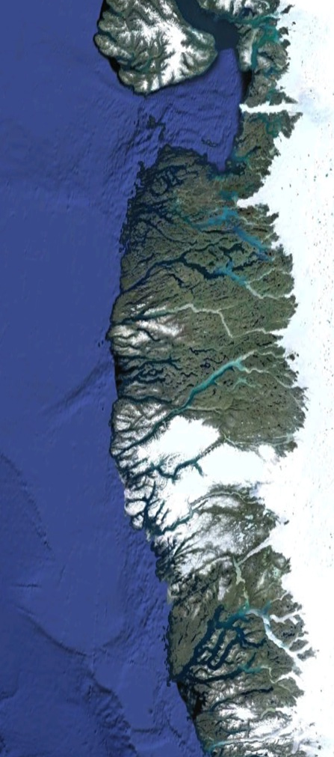
Where do we do what we do?
The Kangerlussuaq study site
1993 - present
Arctic
Circle
100 Km
NSIDC/NASA/Google Earth
Notes:
West Greenland, 180km from the coast

Slide 15
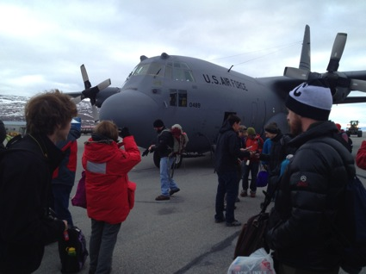
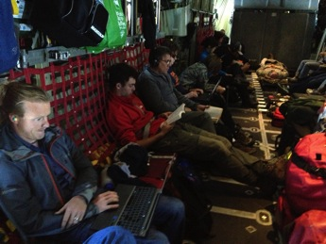
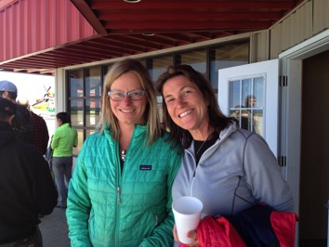
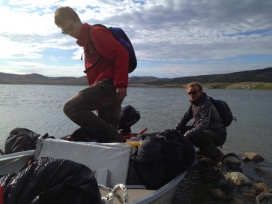
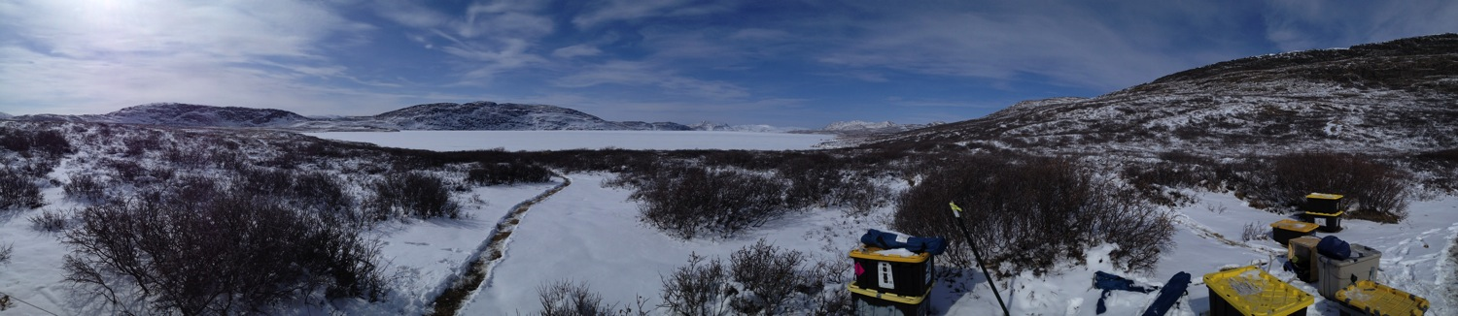
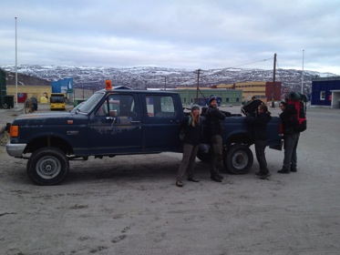
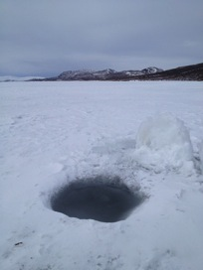
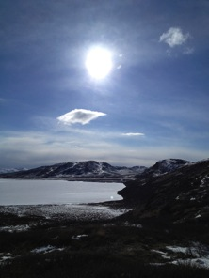
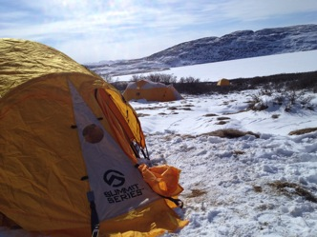
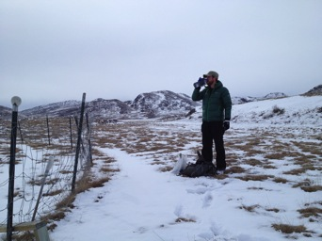
How do we get there and what is it like to be there?

Slide 16
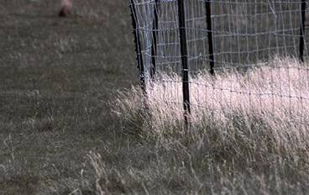
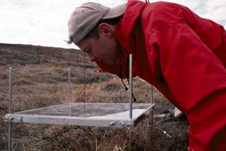
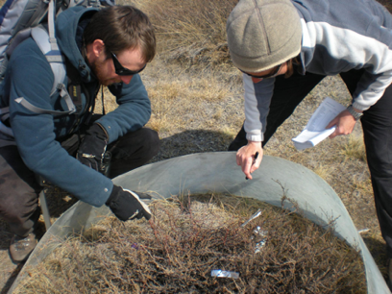
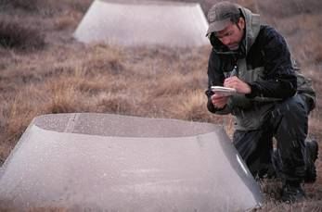
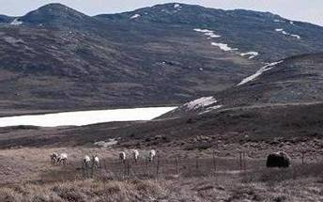
What do we do while we’re there?
Herbivore removal experiment
Non-destructive plant sampling
Plant phenology
Warming experiment
Caribou & muskox monitoring

Slide 17
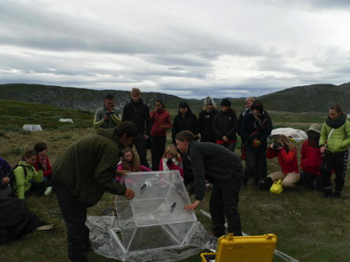
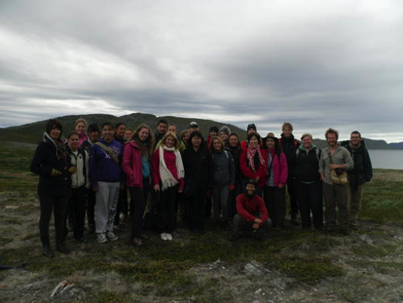
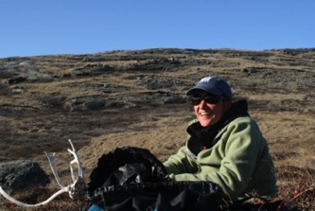
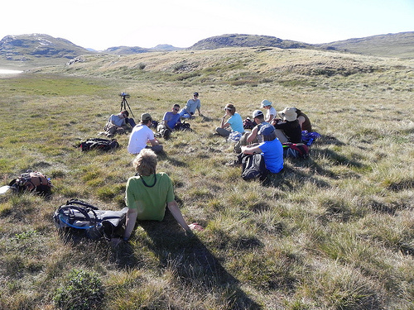
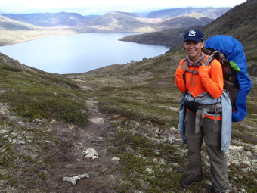
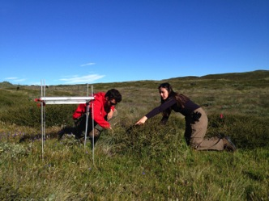
The Kangerlussuaq Study Site
Not just research - education and outreach too.
Kangerlussuaq JSEP Field School since 2008
Greenlandic, Danish, U.S. high school students
Middle- and high school
educators
Undergraduate
honors theses
Dartmouth College IGERT
since 2011
Notes:
West Greenland, 180km from the coast

Slide 18
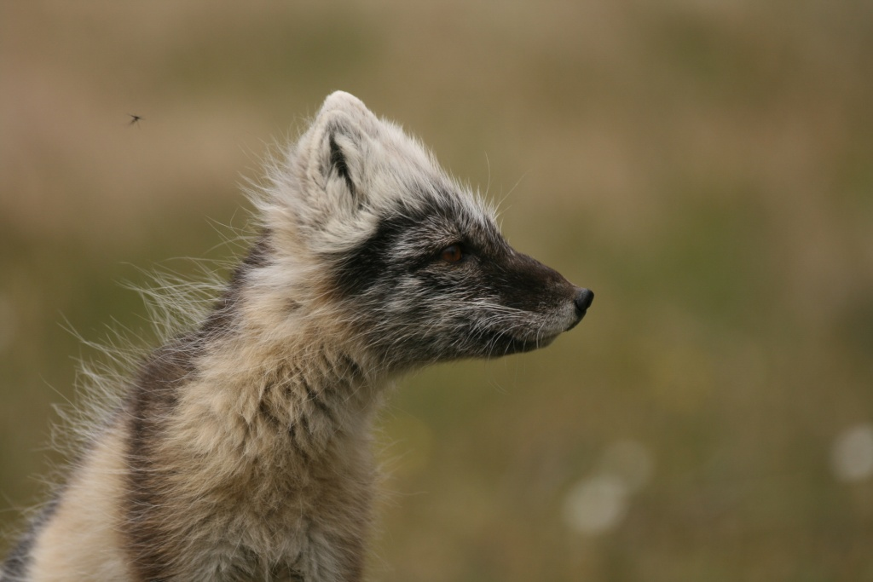
The Kangerlussuaq Study Site
Arctic foxes, but no large carnivores
Notes:
West Greenland, 180km from the coast

Slide 19
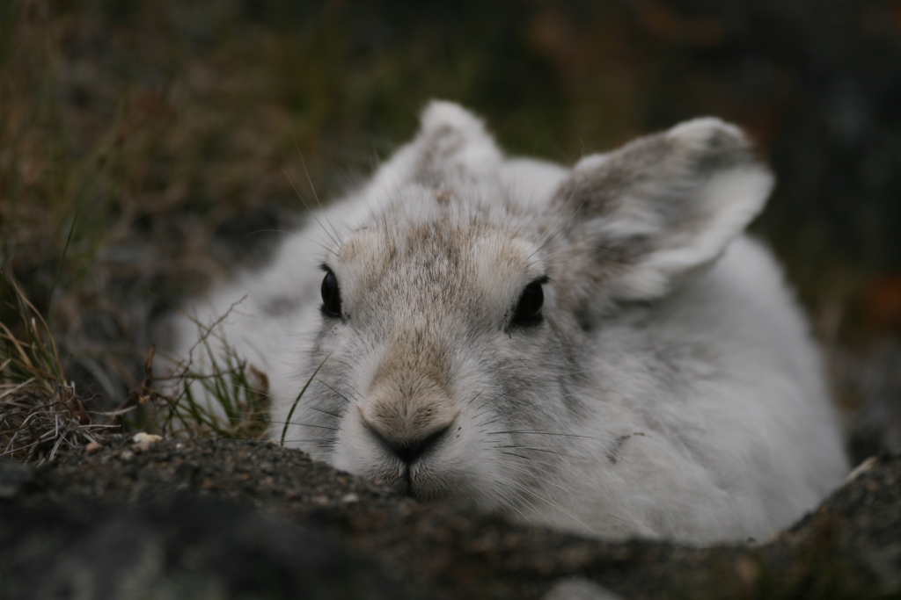
The Kangerlussuaq Study Site
Arctic hares, but no rodents
Notes:
West Greenland, 180km from the coast

Slide 20
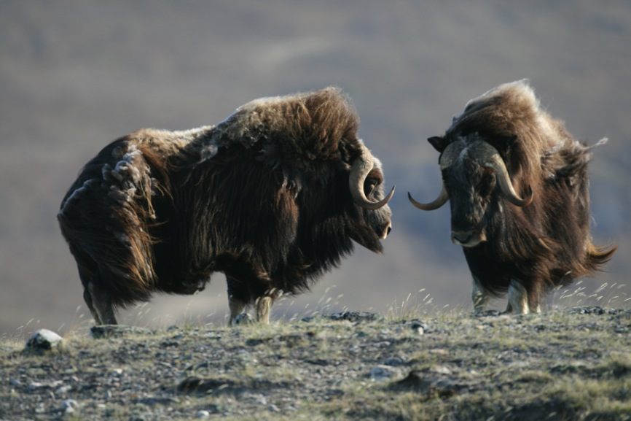
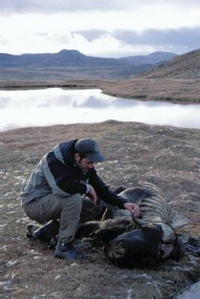
The Kangerlussuaq Study Site
Muskoxen – Pleistocene relics

Slide 21
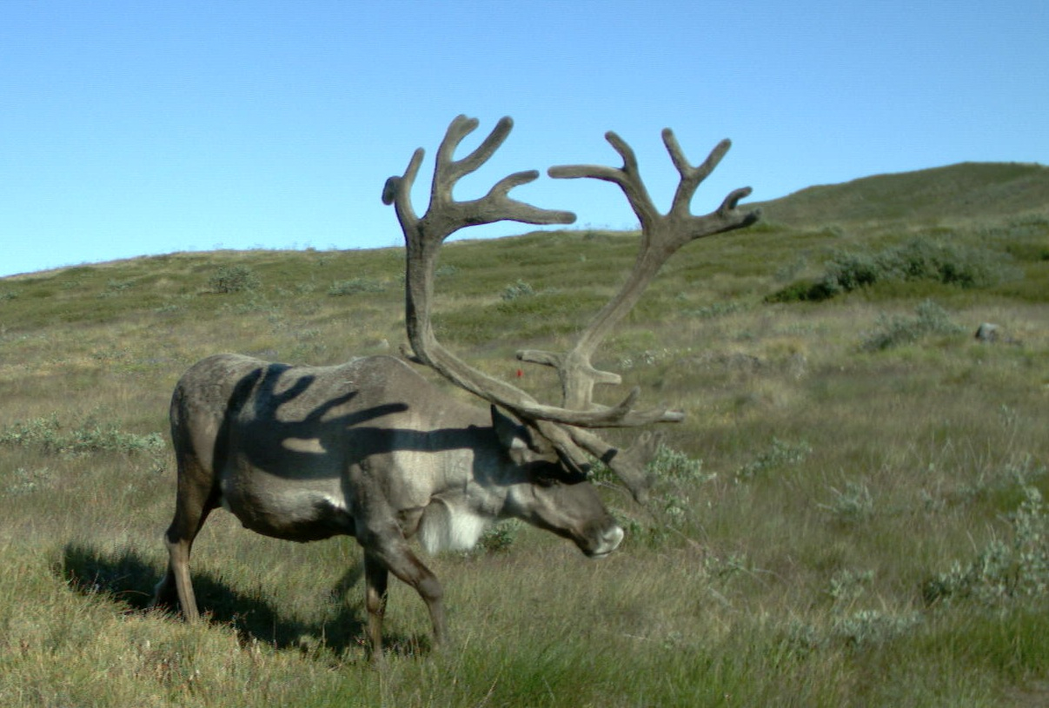
The Kangerlussuaq Study Site
Caribou – Pleistocene relics

Slide 22
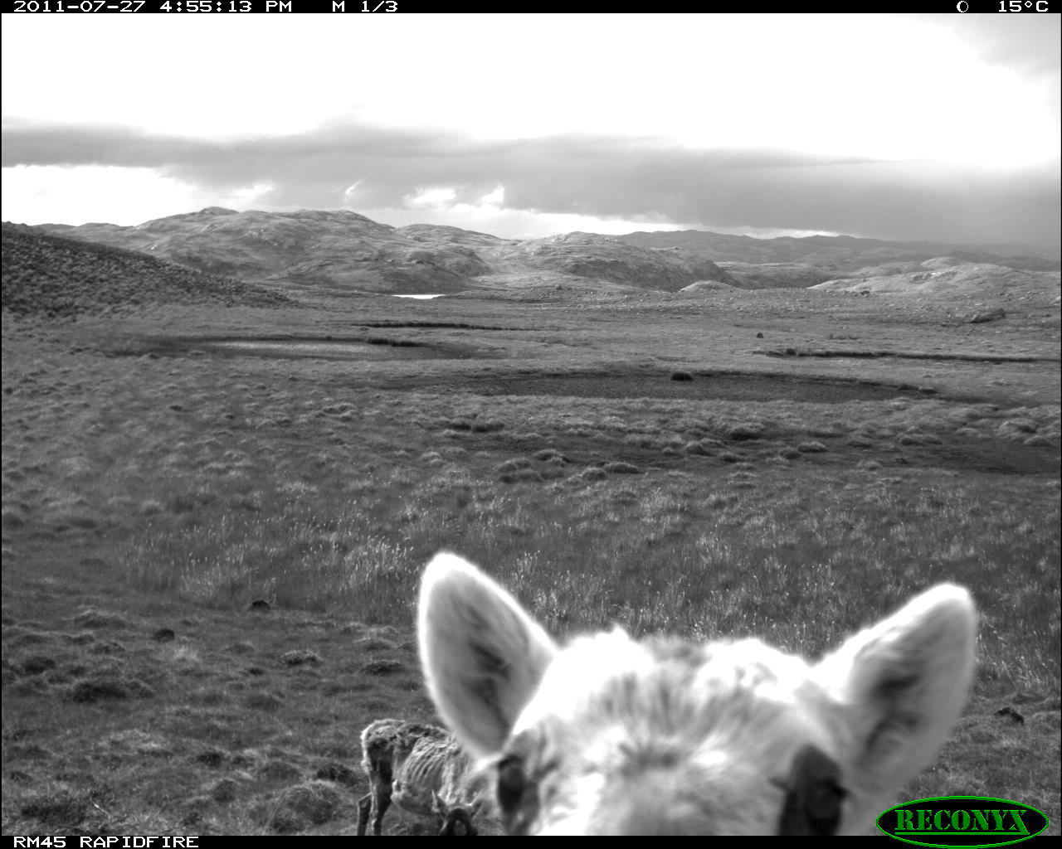
The Kangerlussuaq Study Site

Slide 23
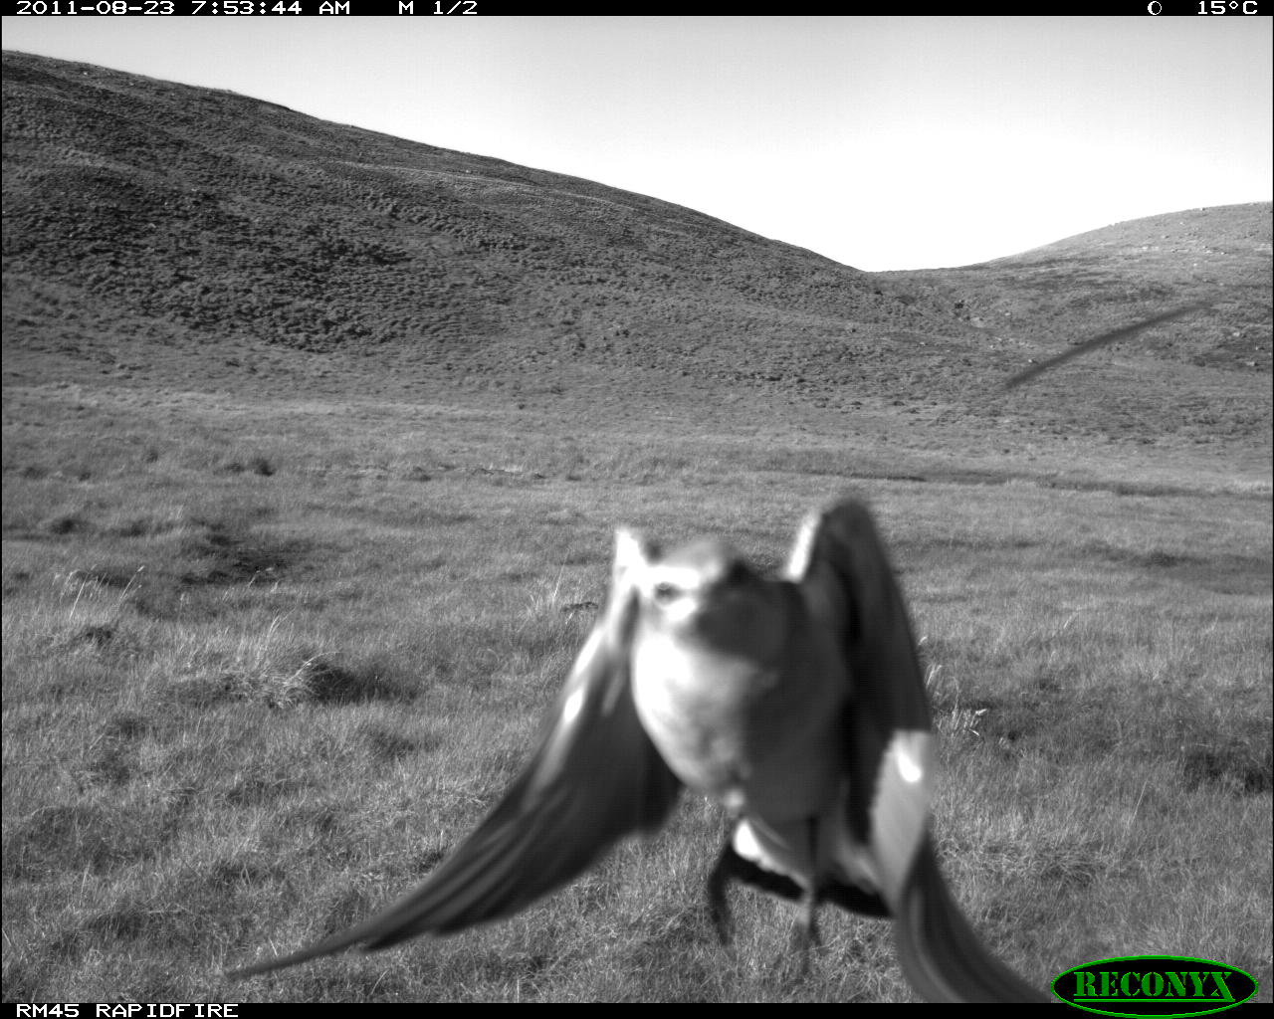
The Kangerlussuaq Study Site

Slide 24
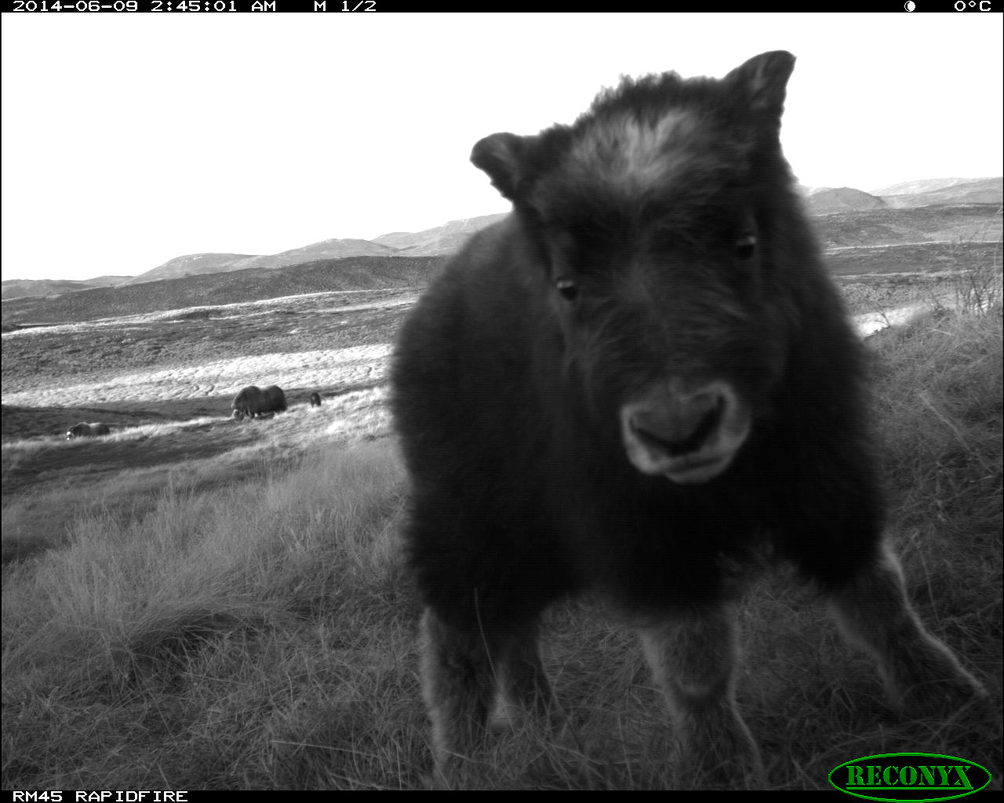
The Kangerlussuaq Study Site

Slide 25
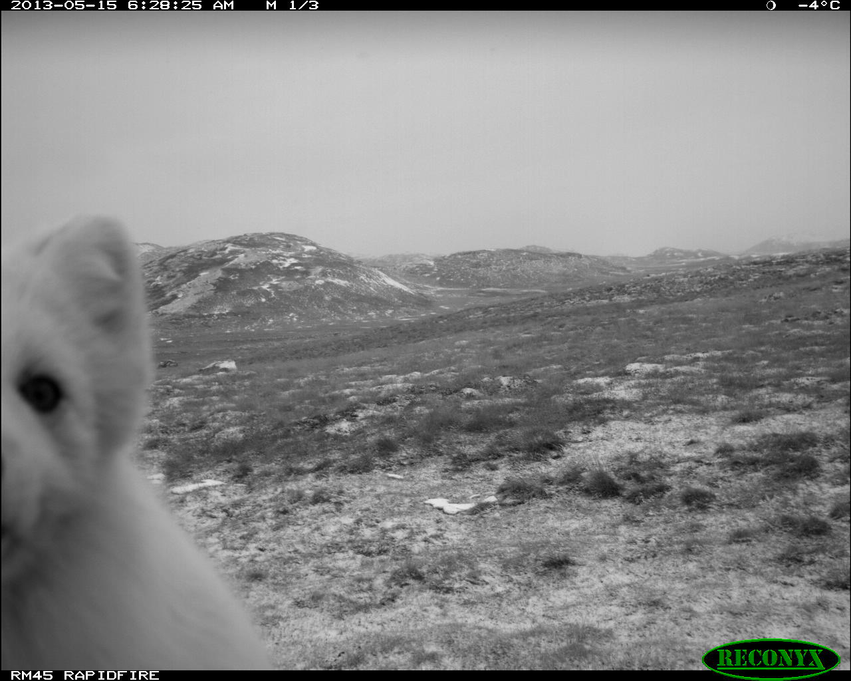
The Kangerlussuaq Study Site

Slide 26
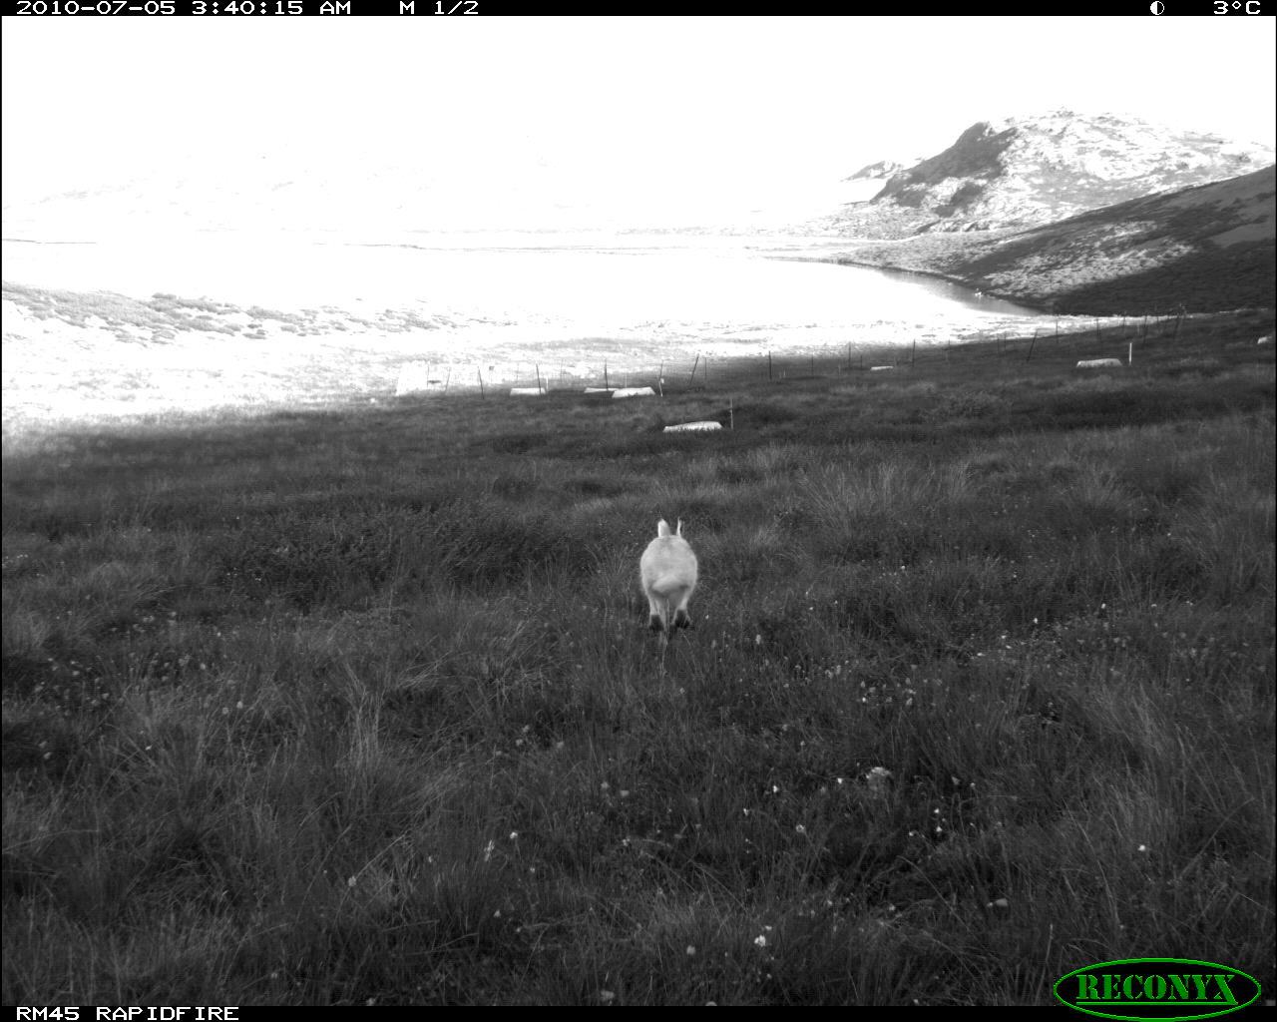
The Kangerlussuaq Study Site

Slide 27
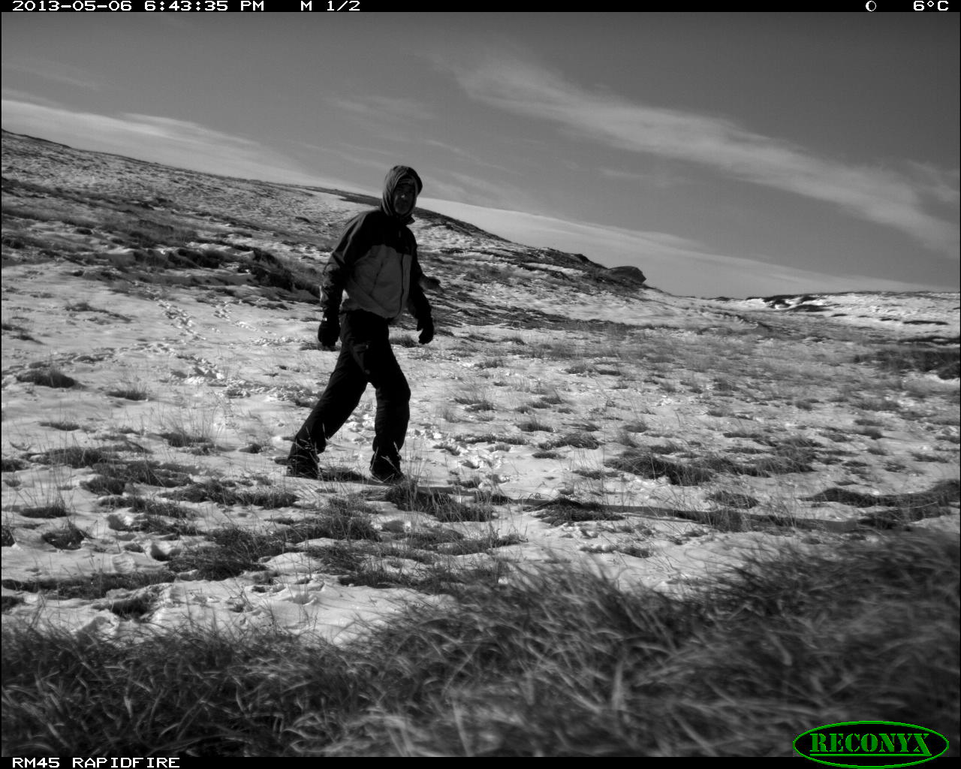

The Kangerlussuaq Study Site

Slide 28

The Kangerlussuaq Study Site

Slide 29

The Kangerlussuaq Study Site

Slide 30


If seasonality is changing in the Arctic, how will this affect species interactions?
Caribou exhibit migratory phenological dynamics into and out of the study site
Muskoxen are resident year-round, but cycle through the study site

Slide 31
Caribou have been declining at the site, but muskoxen appear stable

Slide 32

Why caribou?

Slide 33



Why caribou?

Slide 34



Why caribou?

Slide 35


Why caribou?

Slide 36
How has the Kangerlussuaq study site changed?
Mean annual- and growing season temperatures:
+ 2ºC
+ 1.2ºC

Slide 37

How has the Kangerlussuaq study site changed?
Mean annual- and growing season precip:
Mean annual total = 156mm

Slide 38



Phenology: how has the plant growing season changed at Kangerlussuaq?
The start of the growing season has advanced by 26 days over the past decade
b = -0.61
P = 0.22
b = -1.61
P < 0.01
b = -2.62
P < 0.01

Slide 39





Caribou calving monitored daily and concurrently with plant phenology

Slide 40


In contrast to plant phenology, caribou calving has not advanced significantly
P = 0.29
P = 0.10
P = 0.10

Slide 41

The result: trophic mismatch

Slide 42

Earlier plant growth = increasing mismatch
P = 0.002

Slide 43


Increasing mismatch = lower calf production
P = 0.002
P = 0.005

Slide 44


Increasing mismatch = greater early calf mortality
P = 0.002
P = 0.005
P = 0.01

Slide 45


Human observation is valuable, but not feasible over large areas:
Time-lapse phenology camera network 50 cameras, 40km²

Slide 46

Time-lapse camera network 50 cameras, 40km²
https://vimeo.com/60015098

Slide 47

Species-specific phenological dynamics can be extracted from camera imagery across the landscape

Slide 48





But it’s not all work: we also enjoy this beautiful and fragile system

Slide 49




But it’s not all work: we also enjoy this beautiful and fragile system

Slide 50




But it’s not all work: we also enjoy this beautiful and fragile system

Slide 51






Acknowledgments
Thank you for being part of APPLES!
Penn State (*undergraduate students)
  Tom Adams
  Mike Avery
  Emma Behr*
  Pernille Sporon Bøving
  Jodean Campbell*
  Sean Cahoon
  Christopher Cardillo*
  Todd Costello
  Syrena Johnson*
  Christian John
  Jeff Kerby
  Megan MacArthur*
  Janine Mistrick*
  Christian Pedersen
  Ieva Perkons
  Mason Post*
  Taylor Rees*
  David Watts
  Tyler Yenter
Blue Hill Consolidated School, Maine
  Nell Herrmann
109th Air National Guard
Kangerlussuaq International Science Support, Greenland
  Basse Vængtoft
Professionshøjskolen Metropol, Denmark
  Jesper Bahrenscheer
UC-Santa Cruz
  Chris Wilmers
University of Alaska Anchorage
  Paddy Sullivan
University of Aarhus, Denmark
  Mads Forchhammer
  Toke Høye
Funding:
  NASA
  NSF
  National Geographic Society
  USFWS
  Penn State Institutes of Energy and the Environment

