Slide 1
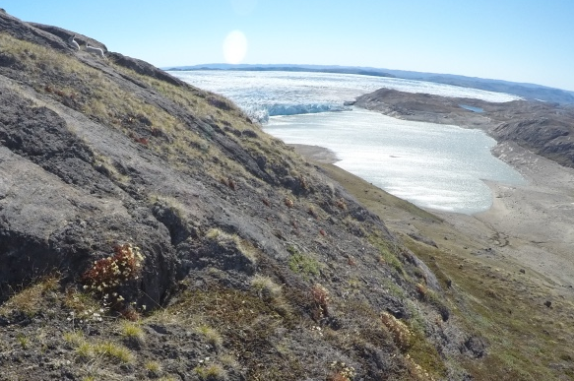
Climate change manifestations
Heidi Steltzer
Fort Lewis College
Learning objectives:
Foundational knowledge in ecology
Conceptualizing cause and effect
understanding feedbacks (positive and negative)

Slide 2
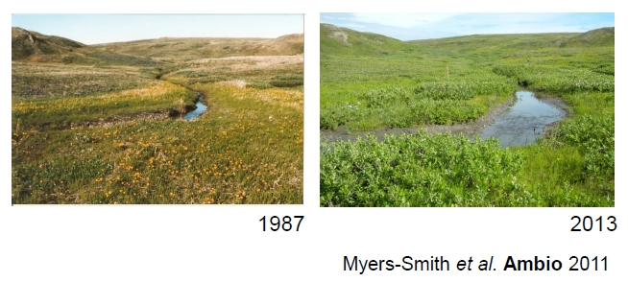
Foundational knowledge in ecology
Biology is the study of life.
Ecology is the study of how living organisms interact with their environment.
Foundational concepts in ecology include:
Trade-offs among traits
Change over time
Population dynamics
Element cycles
Global ecology

Slide 3
Think, pair, share
Which of the following are correct?
In response to climate change, species could ______________________ over time.
A. Go extinct
B. Survive, continuing to live where they currently live without evolving (population size stays similar)
C. Survive, continuing to live where they currently live by evolving (population size stays similar)
D. Migrate/disperse, shifting to region(s) with suitable environment (population size stays similar)
E. Increase in population size, due to greater births then deaths
F......other options

Slide 4
Case studies
Amphibian declines
  Golden toads of Monteverde Cloud Forests, Costa Rica
  https://en.wikipedia.org/wiki/Golden_toad
Adaptation – snowshoe hares
  The color of bunnies, Montana
  http://www.hcn.org/issues/44.2/can-snowshoe-hares-adapt-to-climate-change
Alpine plants tolerance
  Earlier plant senescence, Colorado
  http://www.durangoherald.com/article/20121220/NEWS06/121229999/Early-snowmelt-unhappy-plants
Zika virus
  Range shift for mosquitoes due to climate change could lead to greater spread

Slide 5
Factors that lead to population increase and decline
Notes:
Discussion question: how do populations increase? Provide an example from species just discussed.
Students: Births and immigration, ex. Salt cedar, rays (births greater than deaths), bison (recent increase due to raising them)
Discussion question: how do populations decrease? Provide an example from species just discussed.
Students: Deaths and emigration, ex. polar bear, passenger pigeon, bison (historical deaths), shark, shellfish
Image: from Neff: ‘how populations grow’
Summary:
Bison – increase in deaths due to hunting by people; decrease in deaths and increase in births due to domestication
Polar Bear – increase in deaths due to starvation, risking life to get food; there may also be a decline in births
Passenger pigeon – increase in deaths due to hunting be people
Tamarisk – immigration (due to people); increase in births
Rays – decrease in deaths

Slide 6
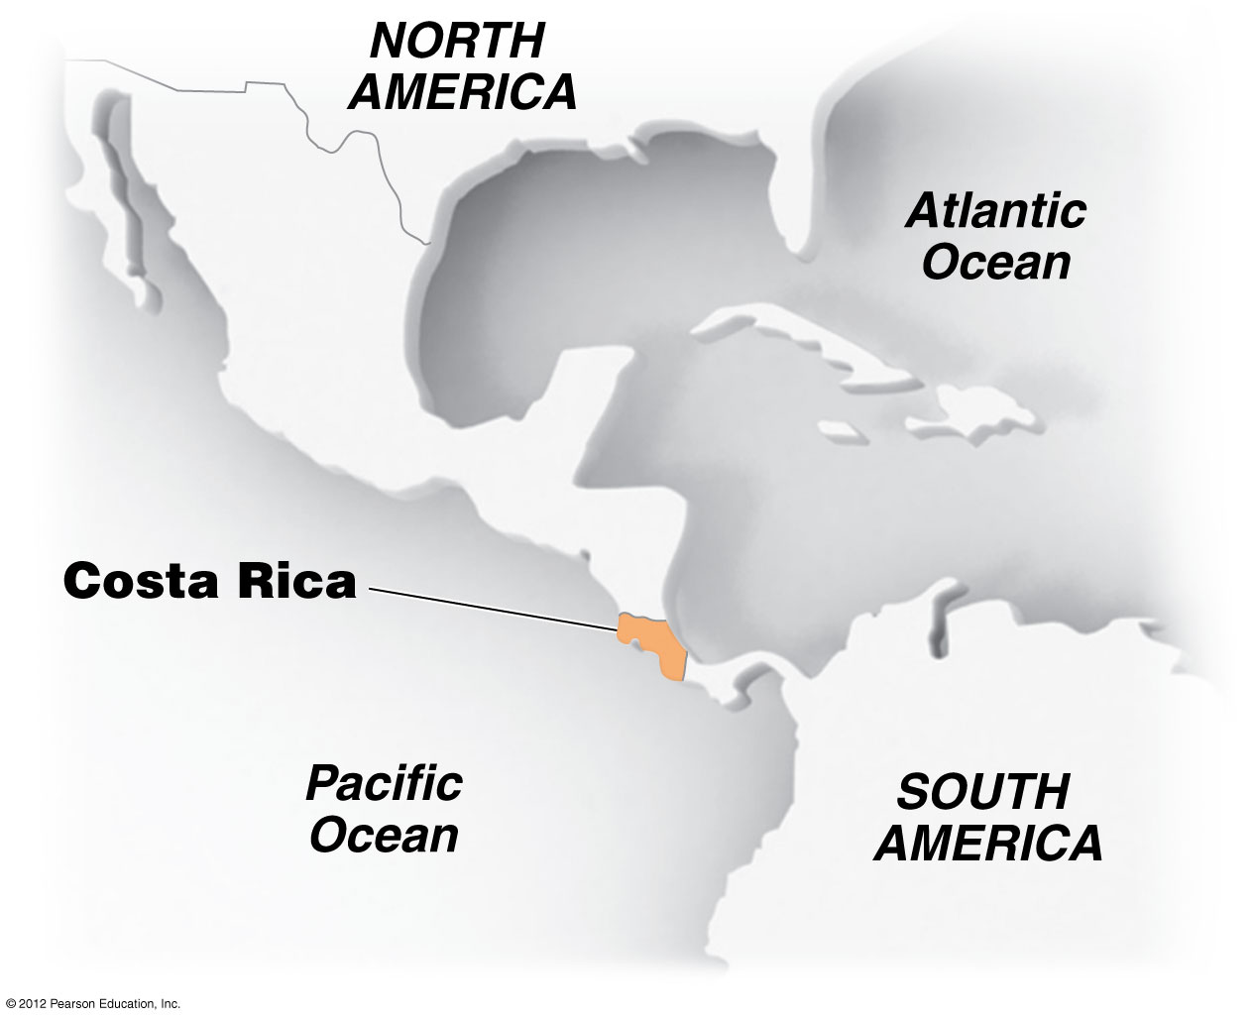
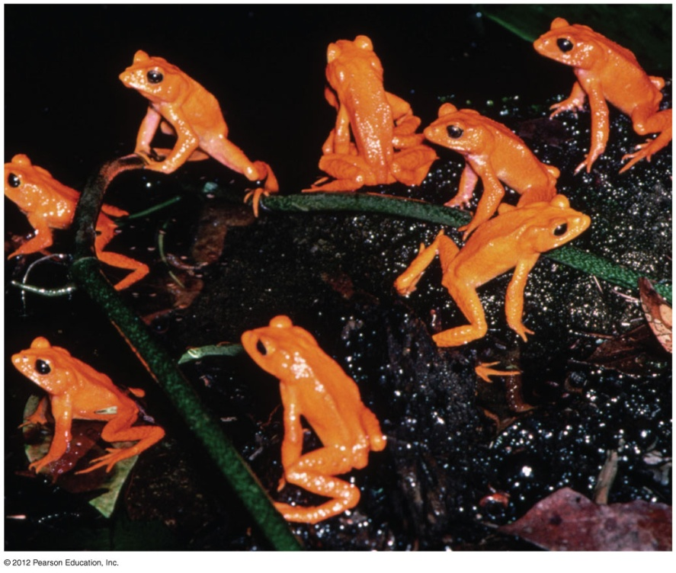
‘Widespread amphibian extinctions from epidemic disease driven by global warming’

Slide 7
Graph interpretation
Describe the data presented in this graph?
What processes could explain this pattern?

Slide 8
What made the population of golden toads vulnerable to extinction?
Small population and highly specialized to climate in small region
Couldn’t move (migrate)
Couldn’t adapt to the changes, stay, and survive.
Couldn’t tolerate the new climate, stay and survive.
Misperception: overemphasis on extinction as key manifestation of climate change.
Reality: climate change will affect life on earth even if few species go extinct; incredibly difficult to determine cause-effect due to many other concurrent changes

Slide 9
Can snowshoe hares outrace climate change?
Research Objective: We investigated whether current levels of plasticity in the initiation or rate of coat color change would be able to reduce mismatch between the seasonal coat color and an increasingly snowfree background expected in the future.
Notes:
Go to link and review online images.

Slide 11
Why study snowshoe hares?
Critical food resource for many predators
key in food webs and prey to US threatened Canada lynx
A member of the most widespread genus showing seasonal coat color change

Slide 12
Snowshoe hare biology
Seasonal camouflage – annual cycle
All start changing about the same time, but the rate of change and the body location at which changes first occur varies among individuals (unique, likely under genetic control)
Photoperiod is the cue for when color change initiates
Eaten by coyotes, wolves, bobcats, martens, lynx
Average life span is just a year (no hares in the study were observed longer than one cycle).
High reproductive rate
More die in fall and spring than winter and summer
Notes:
Seasonal camouflage – change coat color brown to white to brown annual cycle
All start changing about the same time, but the rate of change and the body location at which changes first occur varies among individuals (unique, likely under genetic control)
Photoperiod is the cue for when color change initiates
Eaten by coyotes, wolves, bobcats, martens, lynx
Average life span is just a year (no hares in the study were observed longer than one cycle).
High reproductive rate
More die in fall and spring than winter and summer

Slide 13
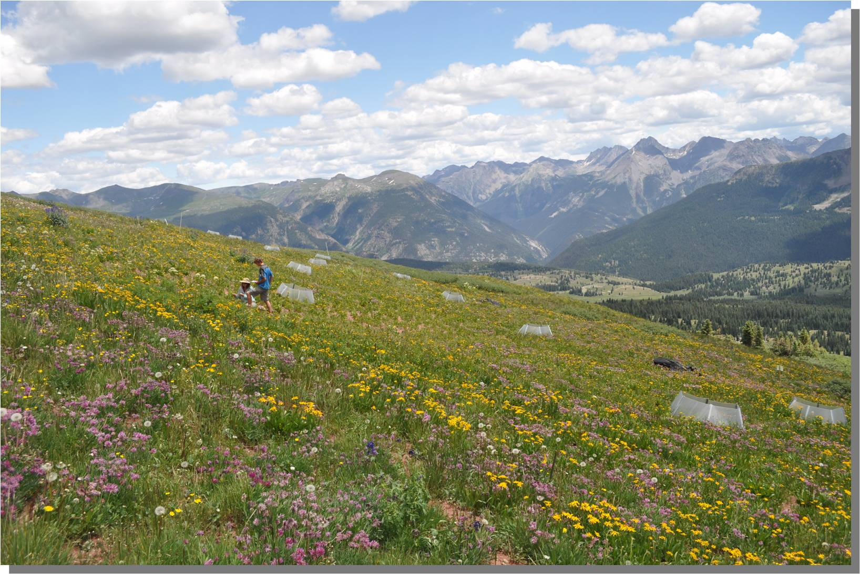
When snow melts early: The unusual alpine plant life histories during summer 2012
Heidi Steltzer and Julie Korb
Kathryn Daly
Esme Sienicki
Grace Fullmer
Emily Cornell
Sarah Bangert
Mike Remke
July 2011, West Turkshead Study Site
Notes:
2012 was an unusual year in the Colorado alpine. Today, I’d like to share with you the results of research I did in collaboration with my colleague, Julie Korb, and our students at Fort Lewis College, including current students and recent graduates.
The setting for our research is an alpine meadow on a hillslope at ~12,000 feet elevation in the San Juan Mountains, SW Colorado. Alpine species in the meadow include many alpine specialist species, such as sky pilot and alpine clover. These are species only found in the alpine tundra.

Slide 14
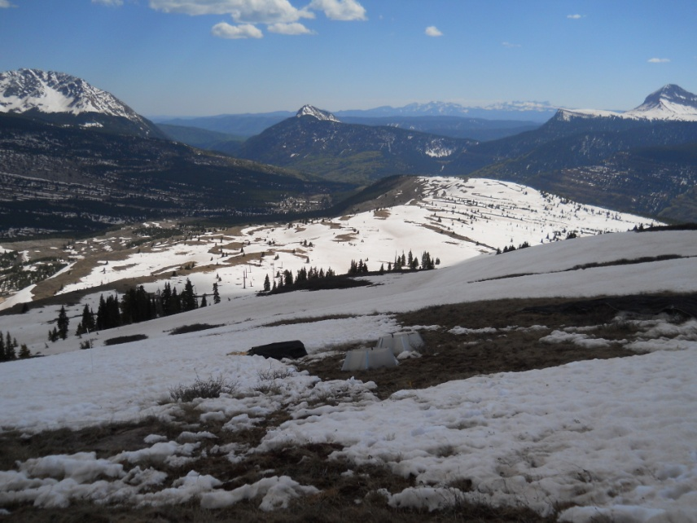
Our study site in mid-June 2011
June 16, 2011, photo: M. Remke
Notes:
In 2012, snow melted early at our study site, over a month earlier than normal. This photo shows what our study site looked like in mid-June 2011, a fairly typical year for snowmelt timing in the San Juan Mountains. Areas are just becoming snowfree at this time.

Slide 15
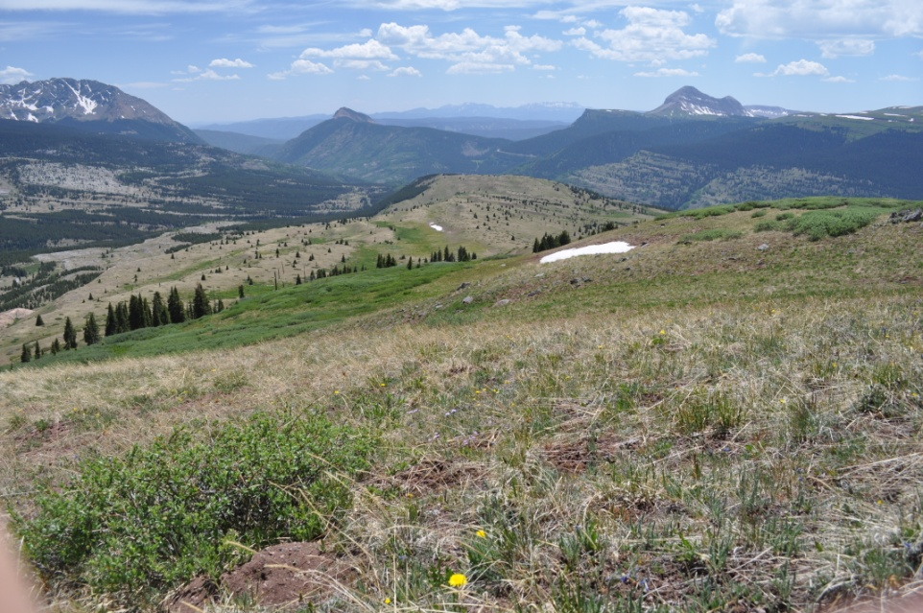
Our study site in mid-June 2012
June 15, 2012
Notes:
And this photo shows what our study site looked like in mid-June 2012. This year snow melt began in mid-April and continued at our site until mid-May. Over this time period, one snow event occurred in mid-April prior to when most of the plots were snowfree and less than 1 mm of rain fell during May and June.
Therefore, climate this year was characterized by early snowmelt and low spring precipitation. The monsoon rains began when they often do in early July, returning water to the alpine tundra. While the 2012 climate year is atypical for past climate, climate years like this could occur more frequently as a result of climate change. Thus, our results provide us with insight into the life histories of alpine plants in the future.

Slide 16
Earlier snowmelt can be tolerated by alpine plants, at least in the short-term
Timing was off
Snowmelt commonly cues many alpine plant species to begin growth and to flower.
  As a result, plant growth and flowering occur soon after snowmelt ~ 10 days and ~20 days, respectively
In 2012, the mean timing for plant growth was 20 to 45 days following snowmelt.
  Many species ‘missed’ the opportunity to use resources supplied by melting snow, which includes water and nitrogen.
Notes:
Prospects do not look good. To begin, the timing was off. The timing of plant growth in relation to snowmelt was off, because snowmelt occurred early and was not the cue many species used to begin growth. Snowmelt commonly does cue alpine species to begin growth and flowering and as a result, plant growth and flowering occur soon after snowmelt, about 10 days and 20 days, respectively.
In 2012, the mean timing for plant growth was 20 to 45 days following snowmelt. The mean timing for flowering was 35 to 60 days after snowmelt. Many species ‘missed’ the opportunity to use resources supplied by melting snow, which includes water and nitrogen. The plants missed lunch and with no rain, dinner was never served.
What we are learning is that alpine species seem to be more conservative than subalpine species and delay growth, awaiting other cues, when snow melts early.

Slide 17
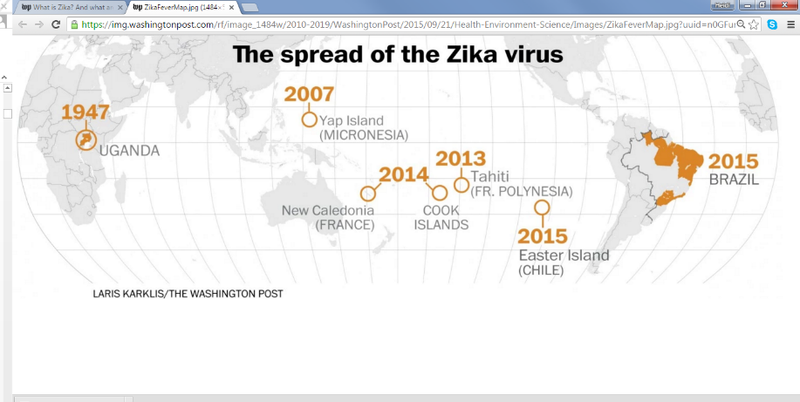
How climate change could worsen the spread of Zika virus

Slide 18
Select a species of interest to you and tell class about how climate change is affecting the species
Assignment rubric:
Climate of region: where species lives, climate, what factors determine climate 10 points
Changing climate: is climate changing, how and why? 10 points
Ecological responses: population dynamics, species interactions 30 points
Feedback and its consequences: a positive or negative feedback that influences climate, population dynamics, or species interactions 20 points
References: one peer-review journal article, 3 other sources 10 points
Organization and effective communication 20 points

Slide 19
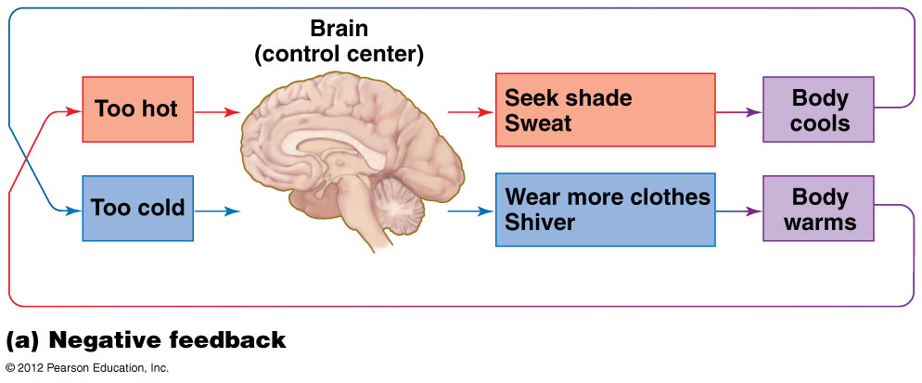
Negative feedback loop

Slide 20
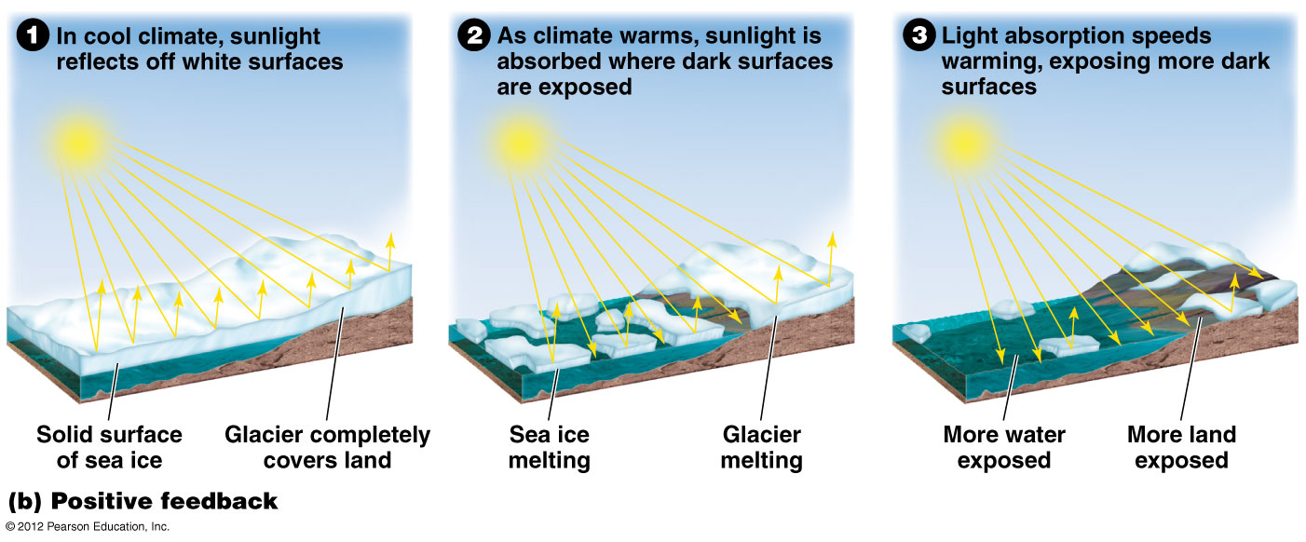
Positive feedback loop

Slide 21
Are positive feedbacks good and negative feedbacks bad?
Generally, no.
It contrasts to how we use the terms positive and negative in daily life.
  Negative feedbacks stabilize a system, which is beneficial for the organisms living in the system.
  Positive feedbacks de-stabilize a system, which is generally disadvantageous for the organisms living in the system.
Scientific research has helped us to understand many positive and negative feedbacks in natural systems, but there are many more we do not yet understand.
  This drives new research – including the research I do.

Slide 22
Concept maps
A concept map is a type of graphic organizer used to help organize and represent knowledge of a subject. Concept maps begin with a main idea (or concept) and then branch out to show how that main idea can be broken down into specific topics.
  The goal of making a concept map is to explore and express understanding of a topic
  concept mapping can be used to confront what one does and does not understand or is not yet known
  Multiple concept maps can be used if information on cause and effect is uncertain – ex. contrasting results within or across studies

Slide 24
How to create a concept map:
For your concept map, label all arrows for process that leads to changes
Include the sun, atmosphere, ocean, mountains and other factors that affect climate and climate change in the environment where your species lives
Include climate/climate change factors for the region within which your species lives – ex. temperature, precipitation, climate events, snow, ice, soil water content
Show how climate/climate change factors are linked to population dynamics of your selected species (number of individuals, number of births, number of deaths, immigration, emigration)
Show how ecological interactions (e.g. predation, parasitism, mutualism, competition, or commensalism) and ecological processes (e.g. photosynthesis, respiration, growth) are affected by climate/climate change for the species you selected and other species that affect the abundance of your selected species.
Include and highlight any feedbacks, ex. does the abundance of the species affect climate? Does one environmental change, such as less sea ice, affect another environmental change? Does the abundance of one species affect the abundance of another in a way that changes the abundance of the first.

Slide 25
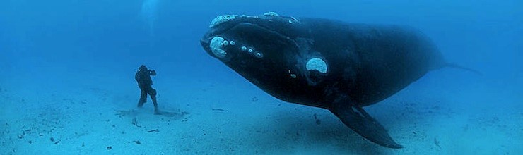
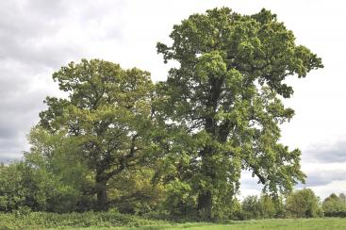
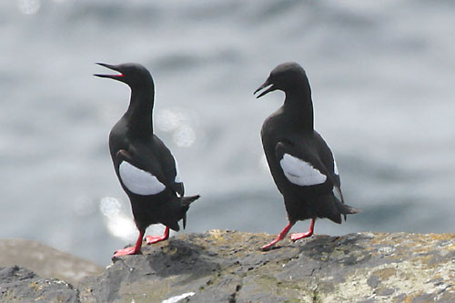
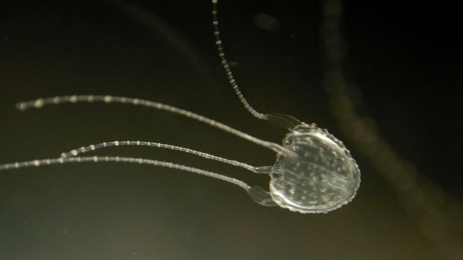
Species students choose –
I learn from them
West Nile Virus
Notes:
Rice
West nile virus
Black Guillemot
Right whales
Irukandji Jellyfish

Slide 26
Ocean Acidification
Decreased Polyp Budding
Population Decline
Climate Change
Stronger East Australian Current
Overfishing
Less competition
More food
Population Increase
Populated Coastal Cities
Nutrient increase
Hypoxia
Farming and Industrial Activities
Positive Feedback Loop
Notes:
Jellyfish off east coast Austrailia

Slide 27
Warmer Atmosphere: More Moisture in air
Ross Sea, Antarctica/Western Antarctic Peninsula
Increased Temperatures
(climate warming)
Increased Snowfall/ Snowpack
Less Snow Free Ground for Breeding
Inability to Breed
Loss of Winter Sea Ice
Highly Ice Tolerant Chinstrap & Gentoo Penguins Population Increase
Increased Competition
Melting Sea Ice Forms Giant Icebergs
Food Depletion: Krill, Plankton, & Other Food Sources Reside Under Sea Ice
Adelie Penguin Population Decrease
Increased Temperatures (climate warming)
Impacts Food Supply Negatively
Reduced Chances of Catching Live Prey
Adelie Penguin Population Increase
More Bare, Snow-Free Ground
Glaciers Retreat
Ability to Breed Better
Notes:
Adelie Penguins

Slide 28
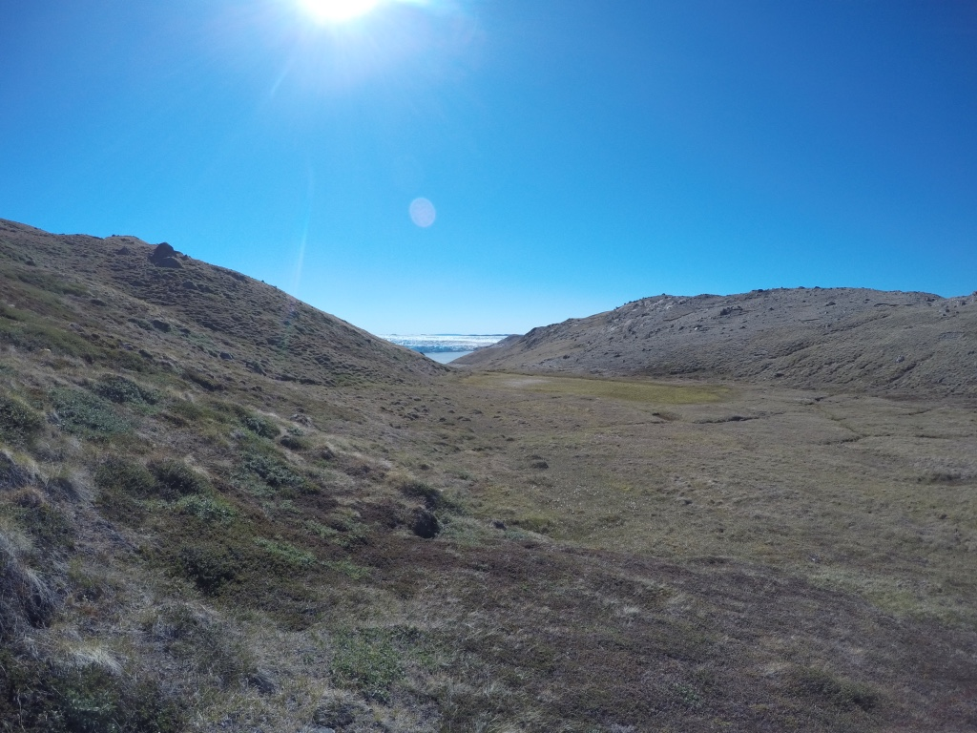
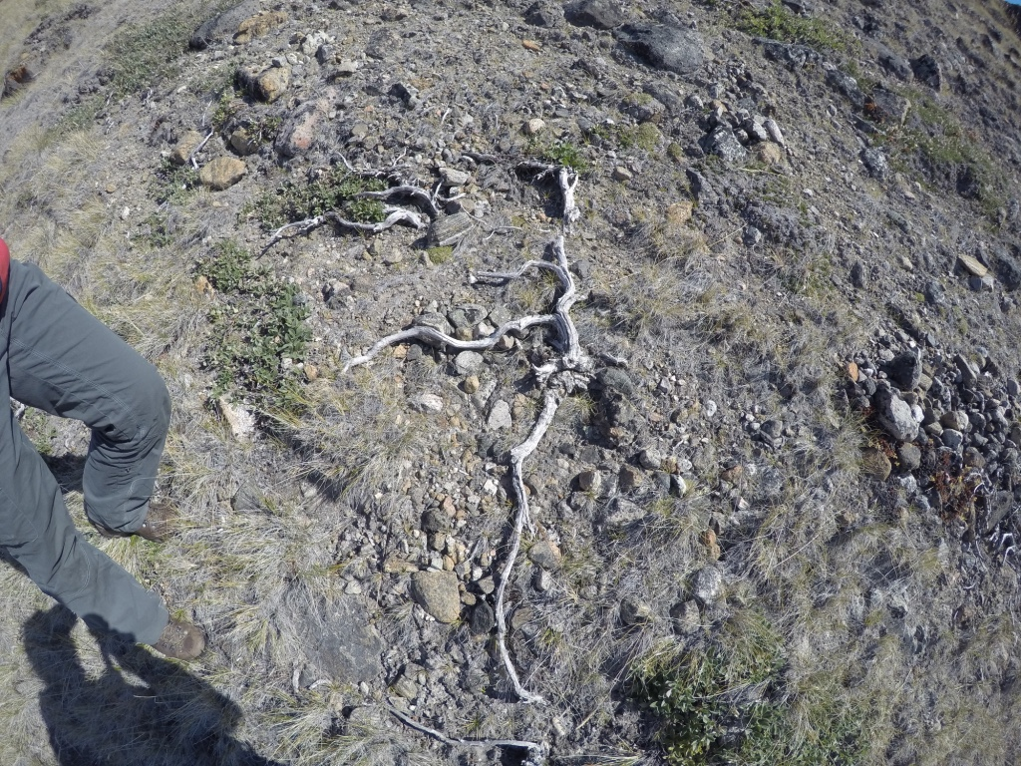
Greenland witnessed its highest June temperature ever recorded on Thursday
By Jason Samenow and Angela Fritz June 10, 2016
Greenland Is Melting Away
http://www.nytimes.com/interactive/2015/10/27/world/greenland-is-melting-away.html?_r=0
Dominoes fall: Vanishing Arctic ice shifts jet stream, which melts Greenland glaciers
https://www.washingtonpost.com/news/energy-environment/wp/2016/05/02/dominoes-fall-vanishing-arctic-ice-shifts-jet-stream-melts-greenland-glaciers/

Slide 29
Climate change is just one way the global environment is changing

Slide 30
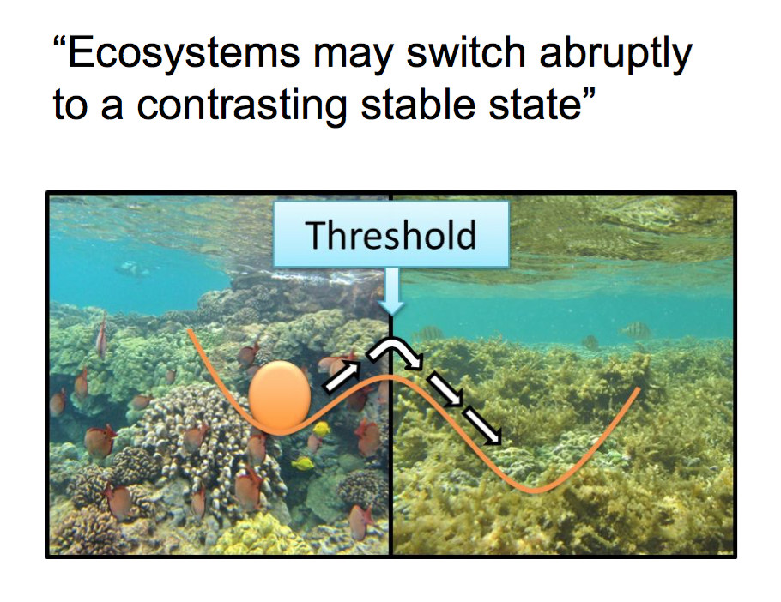
Resilience in ecosystems

